Slide 1
Taxi Analysis
Predicting Taxi Fare Amounts in New York City Using Machine Learning and Deep Learning Approaches

Slide 2
Introduction
In 2019, New York City recorded over 103 million taxi trips, offering a rich dataset for analyzing urban mobility. With the transportation sector contributing around $15 billion annually, accurate fare prediction is crucial for operational efficiency and improved user experience. This study leverages trip data—such as distance, location, time, and passenger count—to enhance fare estimation, supporting smart city initiatives and data-driven urban planning.

Slide 3
Problem Statement
1
2
Taxi fare prediction is difficult in busy cities like New York due to changing traffic, time, and trip distances.
Wrong fare estimates can upset passengers and reduce driver earnings, causing problems in planning and pricing.

Slide 4
Objectives
1
4
Predict taxi fare amounts using historical NYC trip data and identify key factors affecting fare variability
Compare model performance using suitable metrics and offer recommendations to improve fare prediction systems.
2
3
Classify trips into fare categories to support better analysis and decision-making.
Implement and evaluate machine learning models, including traditional, ensemble, and deep learning methods.

Slide 5
This study uses the 2019 NYC Yellow Taxi Trip Records from the TLC dataset, containing over 103 million entries across 12 monthly SQLite files. Sourced from Kaggle, the data includes trip distance, timestamps, fare details, payment types, and location info—providing a strong foundation for fare prediction and urban mobility analysis.
Field Name | Description
VendorID | Code for TPEP provider: 1 = Creative Mobile Technologies, 2 = VeriFone Inc.
tpep_pickup_datetime | Date and time when the meter was turned on (trip started).
tpep_dropoff_datetime | Date and time when the meter was turned off (trip ended).
passenger_count | Number of passengers (entered by the driver).
trip_distance | Distance traveled in miles (from taximeter).
PULocationID | Taxi Zone ID where trip began.
DOLocationID | Taxi Zone ID where trip ended.
RateCodeID | Pricing code (e.g., 1 = standard, 2 = JFK, 5 = negotiated fare, etc.).
store_and_fwd_flag | Y = stored before sending; N = sent in real time.
payment_type | Payment method: 1 = Credit card, 2 = Cash, 3 = No charge, etc.
fare_amount | Base fare calculated by time and distance.
extra | Surcharges like rush hour ($0.50–$1.00).
MTA_tax | Fixed $0.50 MTA tax.
improvement_surcharge | $0.30 fee added at the start of every trip (since 2015).
tip_amount | Tip provided (only for credit card payments).
tolls_amount | Sum of tolls paid during the trip.
total_amount | Final trip cost (excluding cash tips).
Data Overview

Slide 6
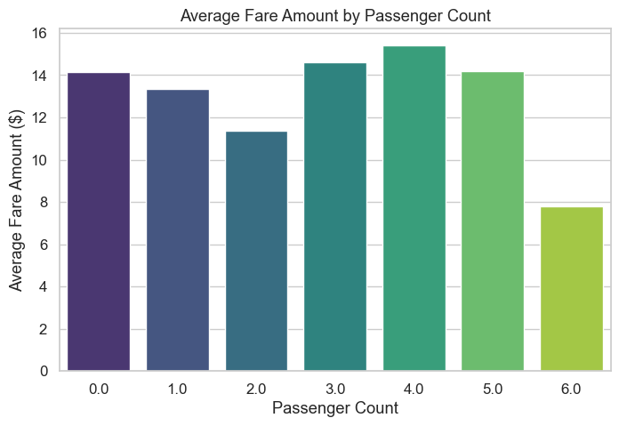
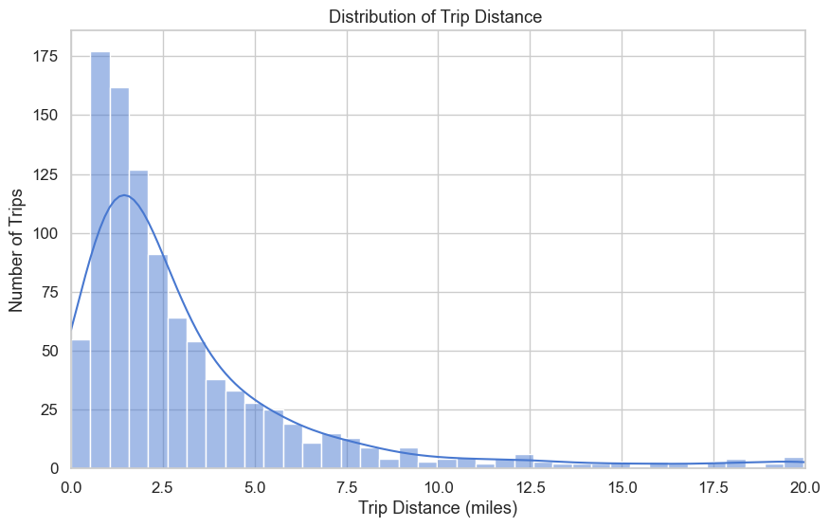
EDA PROCESS
The histogram is right-skewed, showing most trips are short (1–1.5 miles), with fewer long trips extending up to 20 miles.
Average fare peaks at 4 passengers (~$15.50), then drops for 5 and 6 passengers, possibly due to fare rules or data issues.

Slide 7
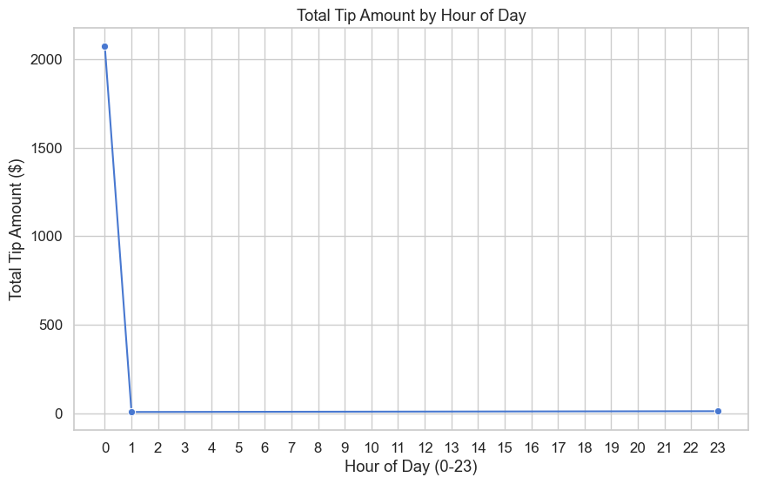
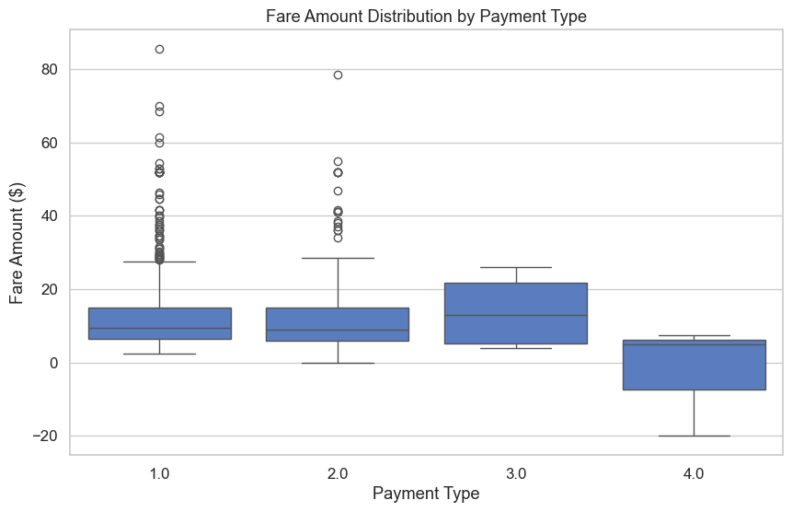
Tips spike sharply at midnight, with minimal values at other hours, suggesting a data anomaly or batch entry at hour 0.
Payment Types 1.0 and 2.0 have similar fares (~$10–12), while Type 3.0 has higher fares. Type 4.0 shows the lowest and some negative fares.

Slide 8
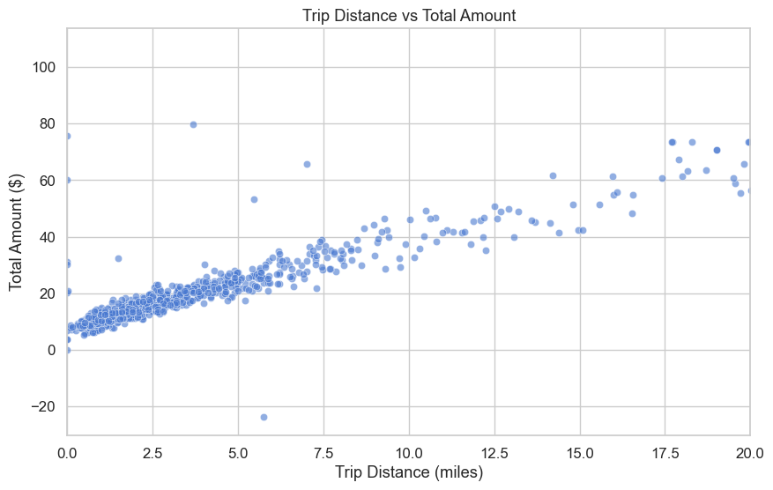
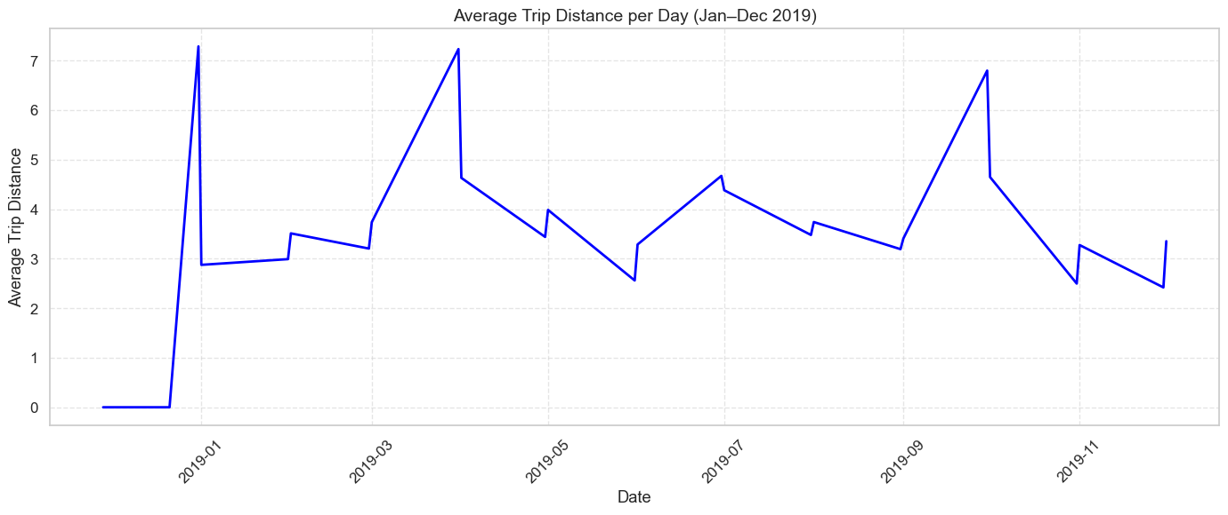
There’s a strong positive relationship—longer trips cost more. Outliers show some high fares for short trips and one refund.
Trip distances vary across the year, peaking in spring and fall (up to 7 miles) and dipping in summer and year-end (around 3 miles).

Slide 9
02
Methodology

Slide 10
Method | Algorithm/Model | Key Details | Parameters/Settings | Features Used
Distance Metric | Euclidean Distancea | Calculates straight-line distance between points | ∑i=1n​(xi​−yi​)2​ | All standardized features
Instance-Based | k-Nearest Neighbors (kNN) | Predicts fare by averaging nearest neighbors | k = 3 to 15, Euclidean distance | Trip distance, passenger count, pickup time
Supervised Models | Linear Regression | Models fare as linear function of input features | No hyperparameters | Trip distance, passenger count, etc.
 | Decision Tree Regression | Recursively splits feature space to reduce prediction error | Max depth = 5 to 15 | Same as above
 | Support Vector Regression | Captures nonlinear patterns using RBF kernel | C = [0.1, 10], gamma = [0.01, 1] | Same as above
Ensemble Models | Random Forest | Aggregates results from multiple decision trees | 100 trees, max depth = 10, bootstrapping | Same as above
 | Gradient Boosting | Builds trees sequentially to correct errors | 200 trees, learning rate = 0.1, subsample = 0.8 | Same as above
Deep Learning | Feedforward Neural Network | Uses layered architecture with nonlinear transformations | Layers: [128, 64, 32]; Activation: ReLU; Optimizer: Adam; LR = 0.001; Batch = 256; Epochs = 50; Dropout = 0.3 | Normalized features
Unsupervised Models | K-Means Clustering | Partitions data into k clusters using centroids | k = 3 to 7, squared Euclidean, 100 iterations | Trip distance, fare amount (normalized)
 | DBSCAN | Groups dense areas, identifies noise | ε = 0.5, min_samples = 5 | Same as above

Slide 11
Phase / Model | Libraries / Technologies | Purpose
k-Nearest Neighbors (kNN) | NumPy | Numerical operations and array handling
Supervised Models | scikit-learn (sklearn) | Algorithms like Linear Regression, Decision Tree, SVM
Ensemble Models | scikit-learn, XGBoost | Random Forest (bagging), XGBoost (boosting)
Deep Learning Model | TensorFlow or PyTorch | Building and training neural networks
Clustering | scikit-learn | K-Means, DBSCAN, Hierarchical Clustering
Data Manipulation & Analysis | pandas | Data loading, cleaning, preprocessing
Data Visualization | Matplotlib, Seaborn | Plotting graphs, charts, cluster visualization
Python Tools Progress

Slide 12
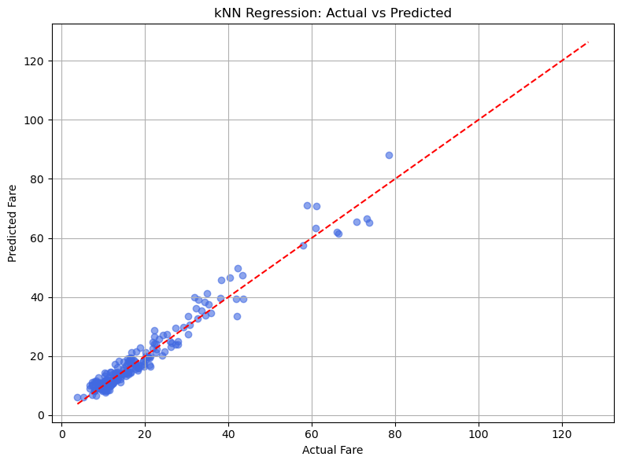
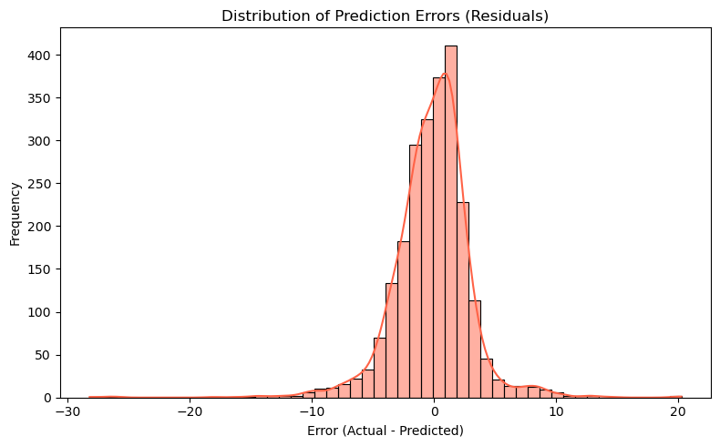
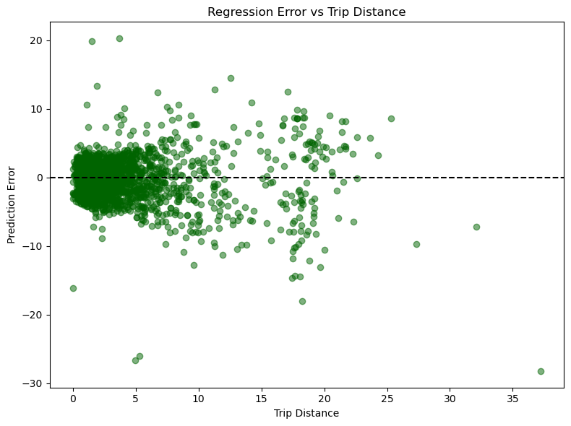
KNN Model
The k-Nearest Neighbors (kNN) regression model showed strong performance on January 2019 taxi trip data. Most fare predictions were accurate, especially for fares under $30, as seen in the tight alignment along the y = x line. Prediction errors were mostly small and centered around zero, with a slight right skew, indicating more under-predictions than over-predictions. Large errors were rare, confirming the model’s reliability.

Slide 13
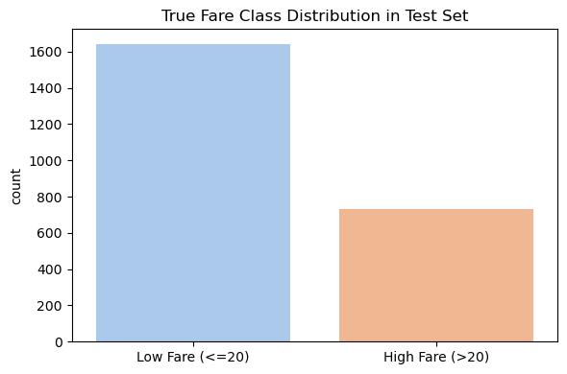
True Fare Class Distribution in the Test Dataset
The bar chart illustrates the true fare class distribution in the test dataset, categorizing taxi fares into "Low Fare (≤ $20)" and "High Fare (> $20)". The distribution is imbalanced, with a significantly higher number of low fare trips—over 1,600 instances—compared to approximately 750 high fare trips. This skew indicates that lower fares are more common in the dataset, which could impact classification model performance and suggests the need for techniques like stratified sampling or class weighting to address potential bias.
4o

Slide 14
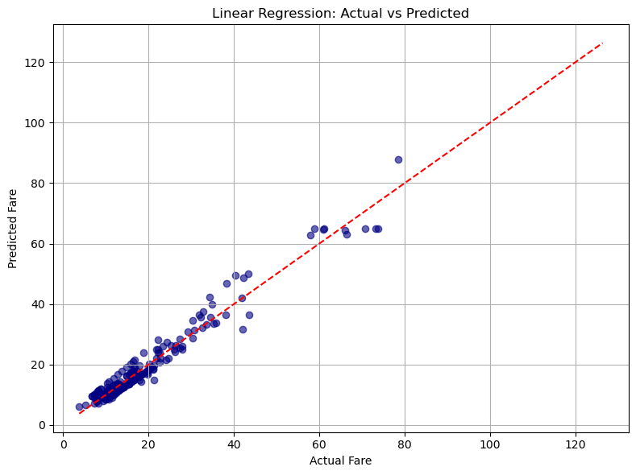
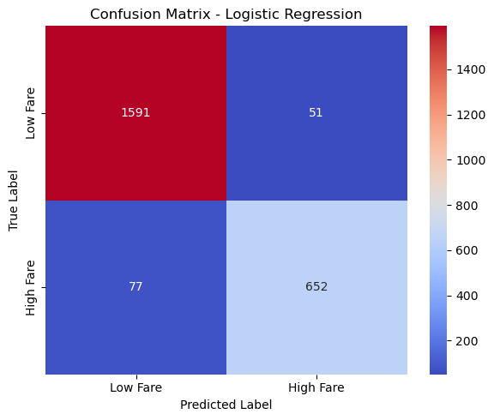
Supervised Learning
The model achieved an RMSE of 2.93, MAE of 2.09, and R² of 0.958, indicating a strong fit. The scatter plot shows predicted fares closely aligned with actual values, though some deviations highlight prediction errors in certain fare ranges.
The model classifies low (≤20) and high (>20) fares with 94.6% accuracy. It achieves precision, recall, and F1-scores of 0.927, 0.894, and 0.911, respectively, performing slightly better on the low fare class due to class imbalance.

Slide 15
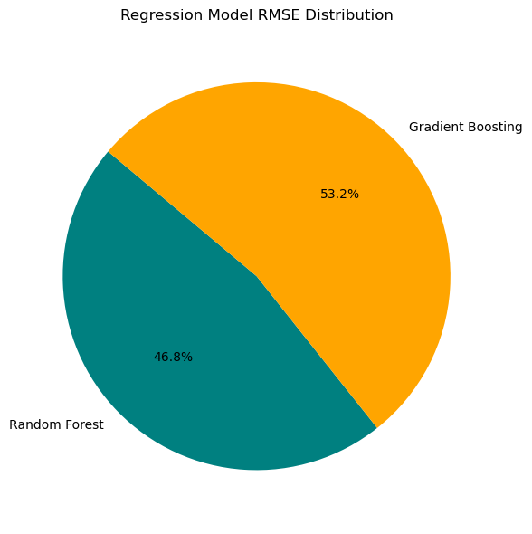
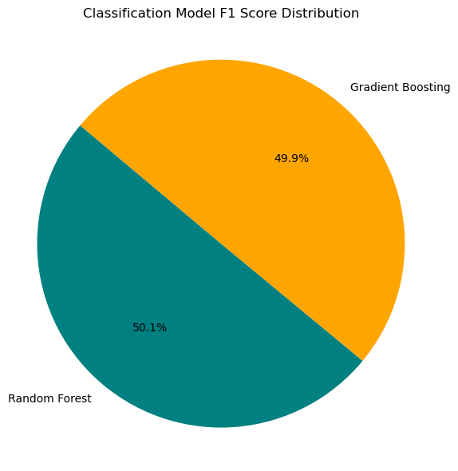
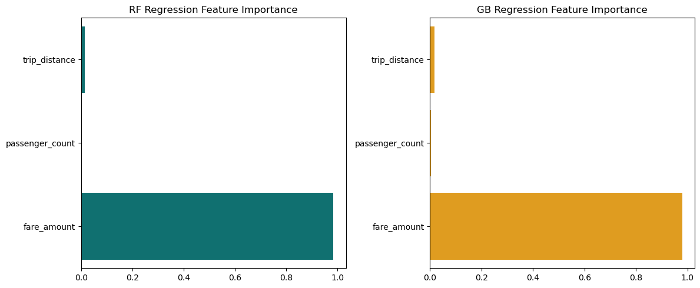
Both ensemble models perform well in regression and classification. Random Forest slightly outperforms Gradient Boosting in regression (RMSE 2.97 vs. 3.37, R² 0.957 vs. 0.945) and shows higher recall in classification (0.930 vs. 0.911). Gradient Boosting has marginally better precision (0.902 vs. 0.892). Overall, both are effective with complementary strengths.
Ensemble Models Performance
The two bar plots show feature importance for Random Forest and Gradient Boosting regression models. In both, "fare_amount" dominates with a normalized score near 1.0, while "trip_distance" and "passenger_count" have minimal impact. Teal and orange colors distinguish the RF and GB models respectively.

Slide 16
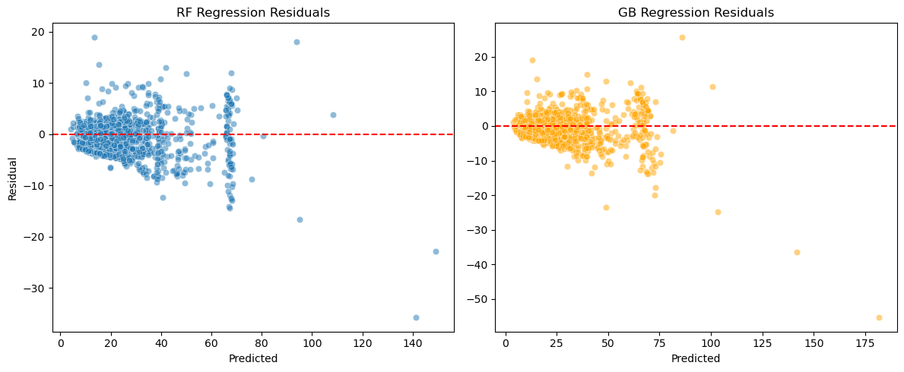
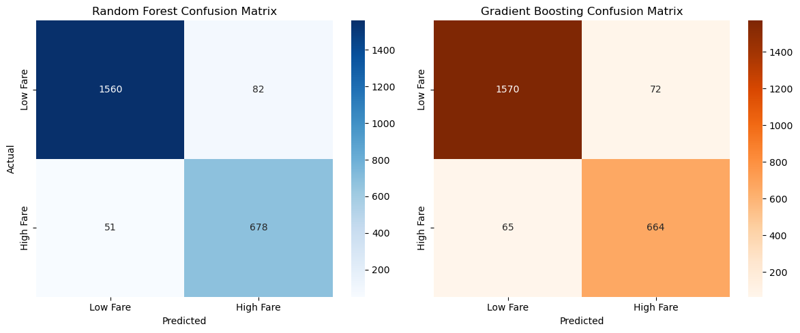
Residual plots for Random Forest and Gradient Boosting models show accurate predictions at lower fare values, with residuals clustered around zero. However, as predicted fares increase, residual spread widens—indicating reduced accuracy. Random Forest also shows a slight downward trend, suggesting underprediction for higher fares and potential heteroscedasticity.
The Random Forest model correctly predicted 1560 low and 678 high fares, while Gradient Boosting achieved 1570 and 664 respectively. RF had 82 false positives and 51 false negatives; GB had slightly fewer false positives (65) but more false negatives (72), indicating comparable overall accuracy with slight trade-offs in error types.

Slide 17
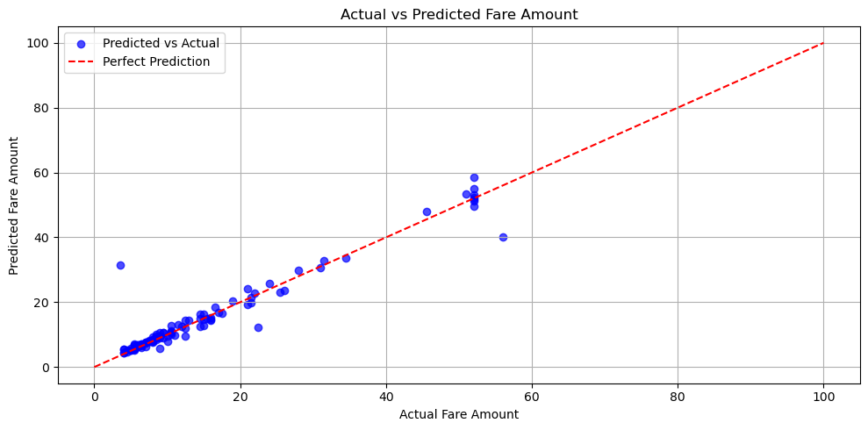
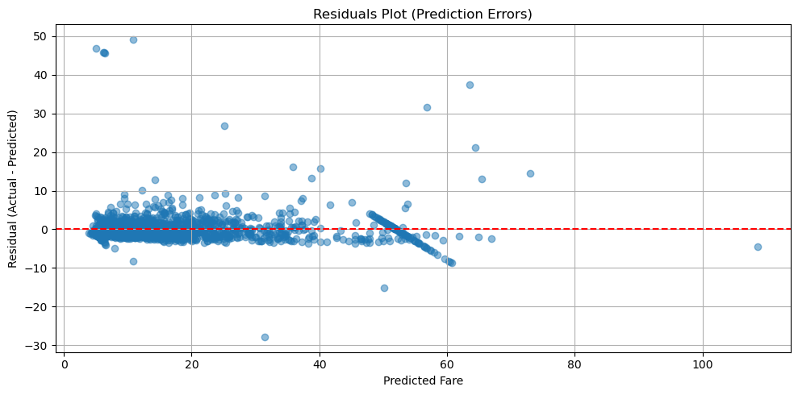
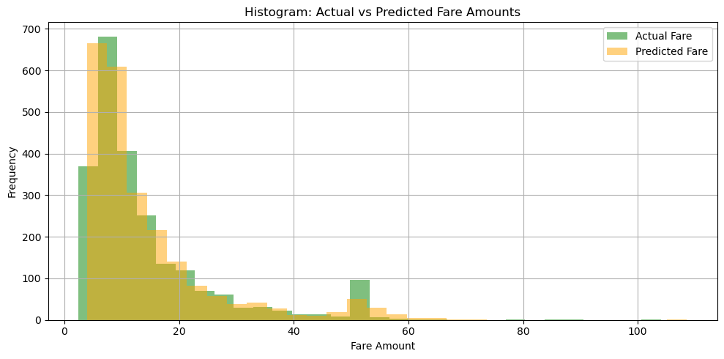
Deep Learning Model
The scatter plot shows strong alignment between actual and predicted fares for lower amounts, with predictions clustering near the ideal line, but reveals increased under prediction and scatter at higher fares, indicating a slight decline in model accuracy at those levels.
The residual plot shows accurate predictions for low fares, with errors centered around zero, but increasing underestimation and variability for higher fares, indicating reduced model performance at those levels.
The residual plot indicates good accuracy for low fares but shows rising errors and underestimation for higher fares, revealing weaker model performance at higher fare levels.

Slide 18
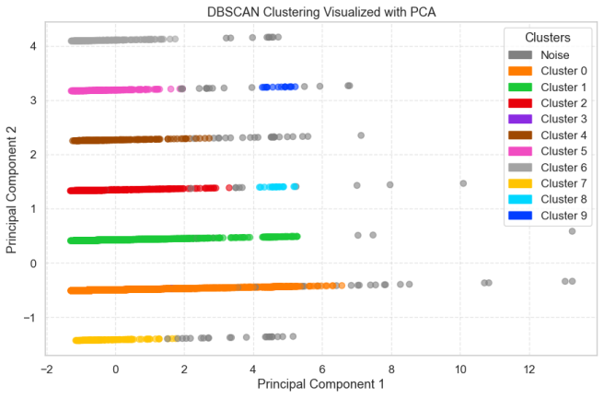
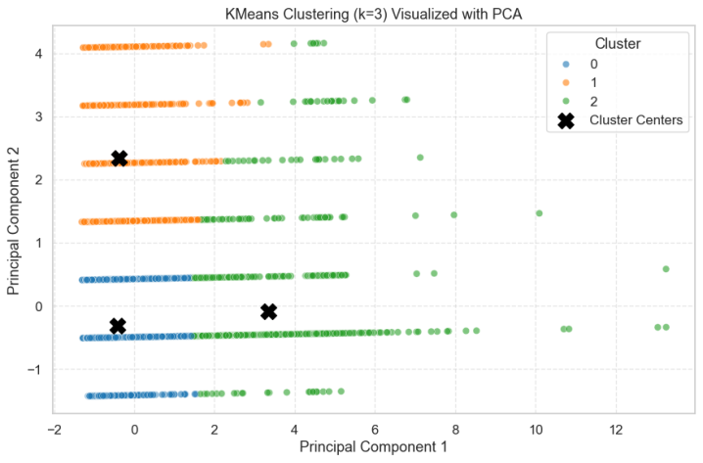
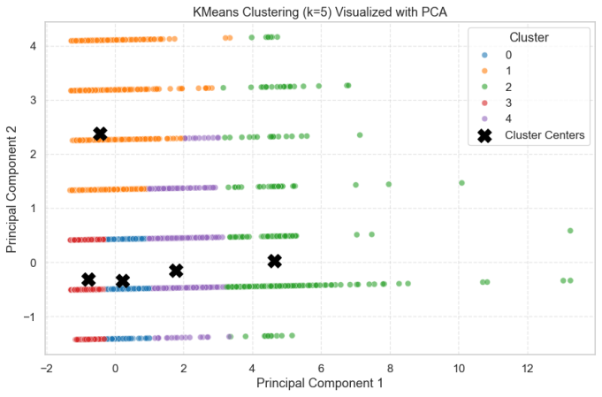
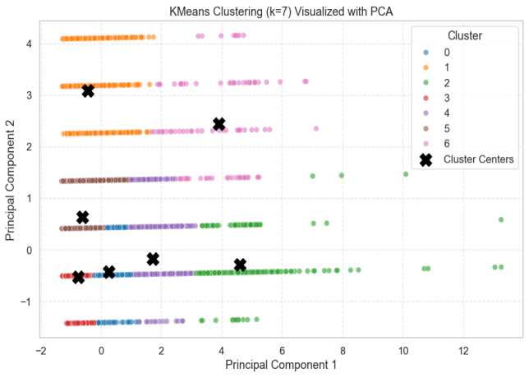
Clustering K Means
The PCA-based scatter plots compare DBSCAN and K-Means clustering, with DBSCAN revealing 10 flexible clusters and outliers, while K-Means (k = 3, 5, 7) forms fixed, centroid-based clusters. The visualizations highlight DBSCAN’s ability to detect irregular shapes and K-Means’ sensitivity to the chosen number of clusters.

Slide 19
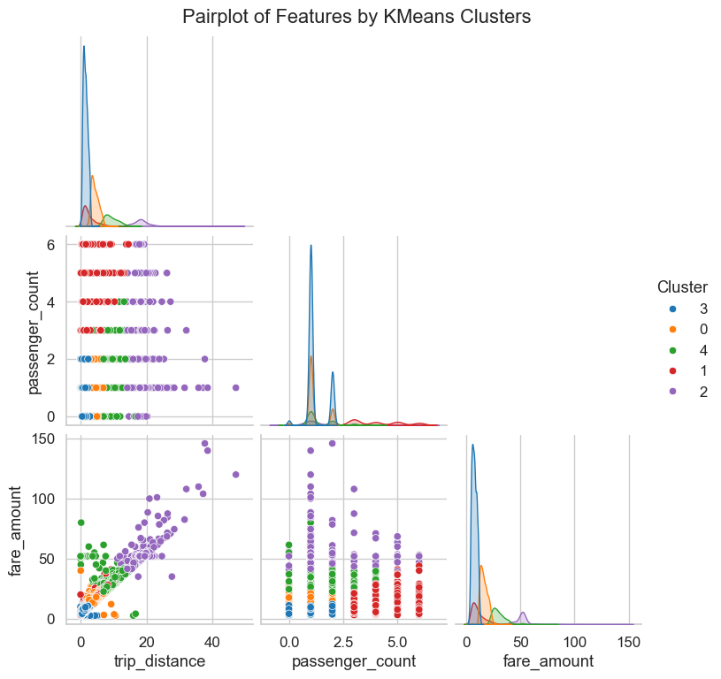
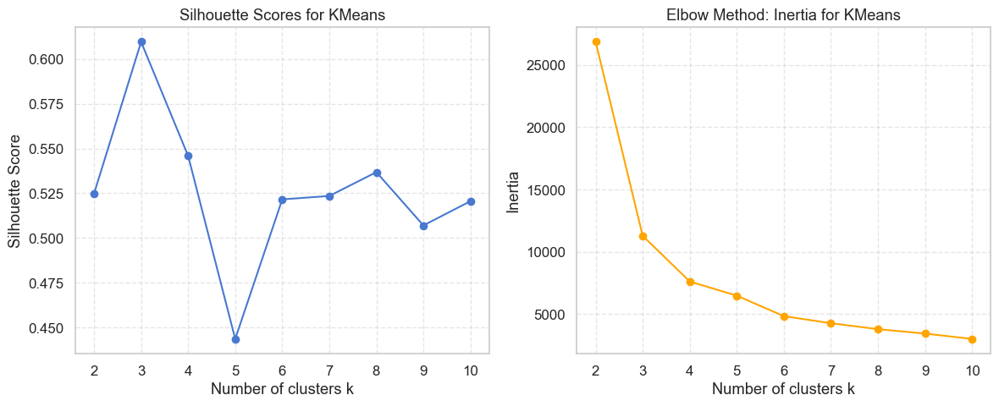
The Silhouette Score and Elbow Method plots suggest that k = 3 is the optimal number of clusters. It provides the highest silhouette score (above 0.60) and a sharp drop in inertia, indicating well-separated, compact clusters with minimal gains beyond this point.
The Silhouette Score and Elbow Method plots indicate that k = 3 is optimal for K-Means clustering, offering the best balance of well-separated, cohesive clusters and minimal within-cluster variance, with little improvement beyond this point.

Slide 20
Key Findings from Model Results
Category | Model / Method | Key Performance Metrics | Insights / Observations
Regression | Linear Regression | RMSE: 2.93, MAE: 2.09, R²: 0.958 | Strong fit; closely aligned predictions with actual fares; minor bias in some ranges
 | kNN Regression | Visual: Tight clustering below $30 | High accuracy for short trips and low fares; larger errors for long trips; right-skewed residuals
 | Random Forest | RMSE: 2.97, MAE: 2.08, R²: 0.957 | Slightly better than GB; strong performance and generalization
 | Gradient Boosting | RMSE: 3.37, MAE: 2.17, R²: 0.945 | High precision; slight underperformance vs RF; good overall accuracy
 | Deep Learning (DNN) | RMSE: 3.22, MAE: 1.48, R²: 0.93 | Best MAE among all; excellent low-fare prediction; underestimates high fares slightly
Classification | Logistic Regression | Accuracy: 94.6%, F1: 0.911 | Performs well on both classes; favors low-fare due to class imbalance
 | Random Forest (Class.) | Accuracy: 94.4%, F1: 0.911 | Balanced recall and precision; slightly better at identifying high fares
 | Gradient Boosting (Class.) | Accuracy: 94.2%, F1: 0.906 | High precision; more false positives than RF
Clustering | K-Means (k = 3) | Silhouette Score > 0.60 | Best balance of cohesion and separation; k=3 optimal per elbow and silhouette
 | DBSCAN | 10 clusters + noise | Captures complex, non-linear clusters; good for outlier detection
Other Insights | — | — | Residuals show heteroscedasticity (larger errors for longer trips); fare prediction most accurate for short trips and low fares
Feature Importance | RF & GB Regression | Fare amount >> Trip distance, passenger count | Fare amount is dominant predictor; others contribute minimally

Slide 21
Future Scope and Recommendations
Conclusion
Future work could improve performance by adding external data (weather, traffic, events), addressing class imbalance with advanced techniques, and exploring deep learning models like LSTM or Transformers for temporal patterns. Using geospatial clustering (e.g., HDBSCAN) can reveal better location insights. Deploying real-time prediction systems with interactive dashboards would enhance usability for drivers and passengers.
This project evaluated various models to predict taxi fares and classify fare categories using the NYC Yellow Taxi 2019 dataset. Linear regression and ensemble methods showed strong regression accuracy, with deep learning achieving the lowest MAE. Logistic regression and Random Forest performed well in classification despite class imbalance. Clustering uncovered meaningful fare and passenger patterns. Fare amount was the key feature, and models worked best on short trips with lower fares. These insights support improved pricing and service strategies.

